Slide 1
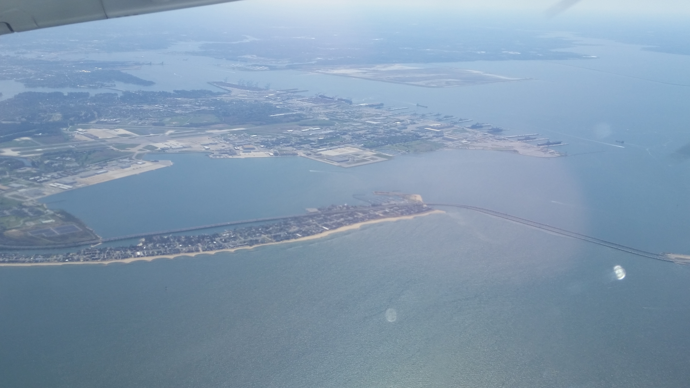
Planning for the Foreseeable:
What can we do now at reasonable costs and reasonable consequences to improve resilience and maintain options?
Commercial buildings have lifetimes of 20 to 50 years
Public buildings have lifetimes of 40 to 60 years
Residential areas have longer lifetimes, up to 150 years
Group Discussions 1:
How much is being rebuilt?
Are we using this opportunity?
What is limiting us from using the opportunity?
Do we know how we should build/rebuild/modernize to be more resilient/better prepared?

Slide 2
Planning for the Foreseeable:
What can we do now at reasonable costs and reasonable consequences to improve resilience and maintain options?
Commercial buildings have lifetimes of 20 to 50 years
Public buildings have lifetimes of 40 to 60 years
Residential areas have longer lifetimes, up to 150 years
Group Discussions 2:
Steps towards a slow adaptation process for the build environment

